Slide 1
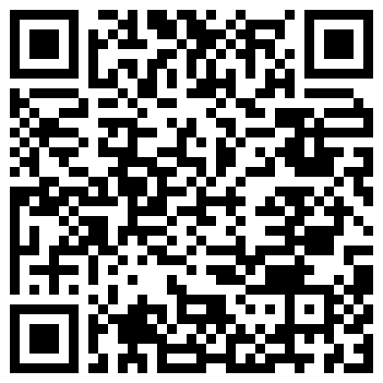
Adipose Determination using
Machine Learning Algorithms
Raj Shekhar
Scan to view live project

Slide 2
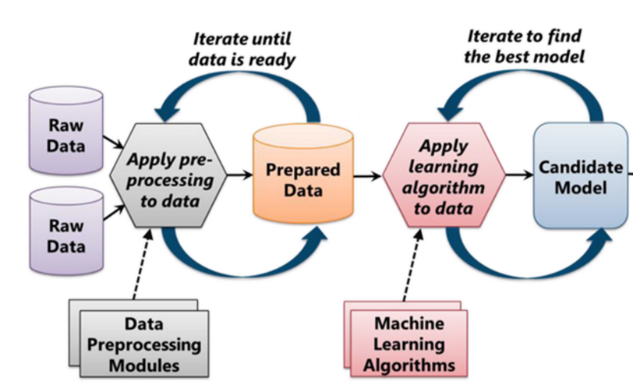
Introduction
Adipose Tissue -> Obesity -> Diseases
Composition of Adipose - Difficult and expensive to find experimentally.
Apply Machine Learning to predict Adipose.
Dataset composition:
241 individuals and 15 measurements.
Flow Chart of Machine Learning Process

Slide 3
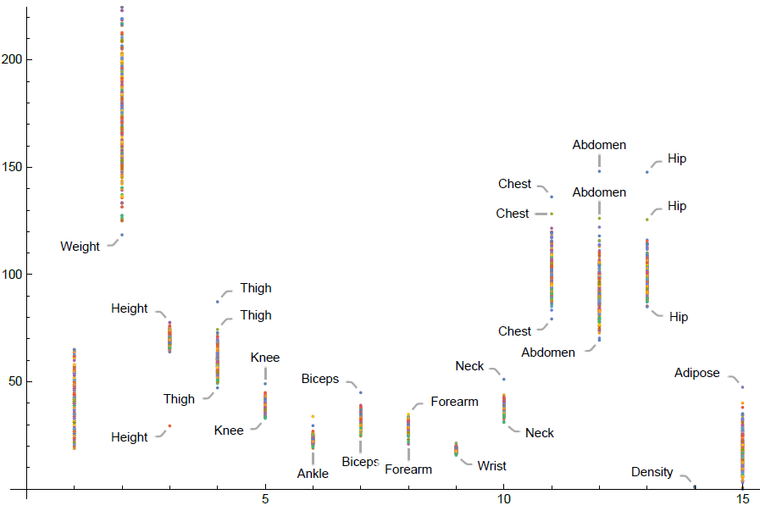
Exploratory Data Analysis
Pre-Processing - Missing Values? Scaling required?
Variable Selection - Optimize using Correlation.
Assumptions are met?
List Plot - Visualizing all variables

Slide 4
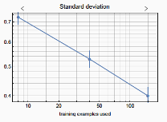
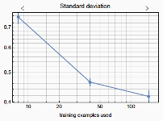
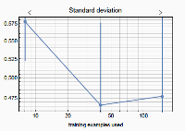
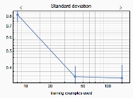
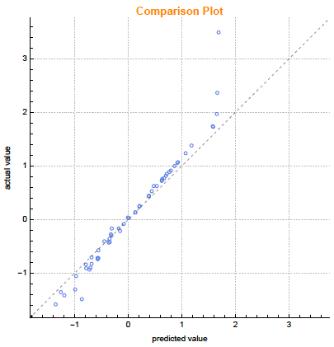
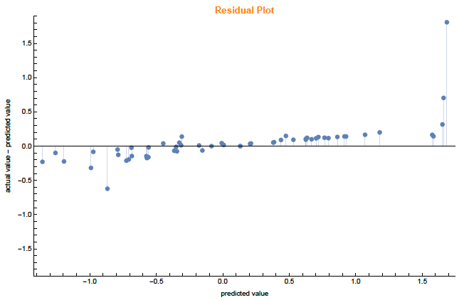
Modelling with Machine Learning Algorithms
Input Data : Training (50% of data), Validation (25% of data) and Testing (25% of data) set.
Linear Regression Decision Tree Random Forest Gradient Boosting
Fig 1 Fig 2 Fig 3 Fig 4
Gradient Boosting Model
Comparison Plot
Actual Value vs Predicted Value
Residual Plot
Standardized Residuals Vs Predicted Value
Fig 5 Fig 6

Slide 5
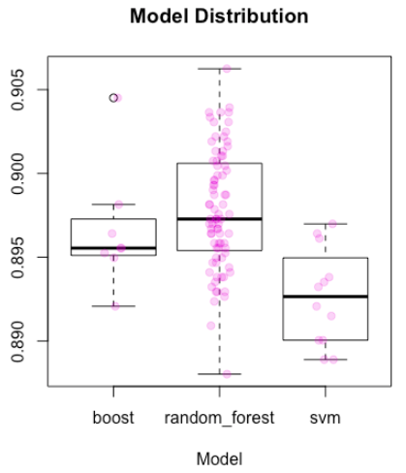
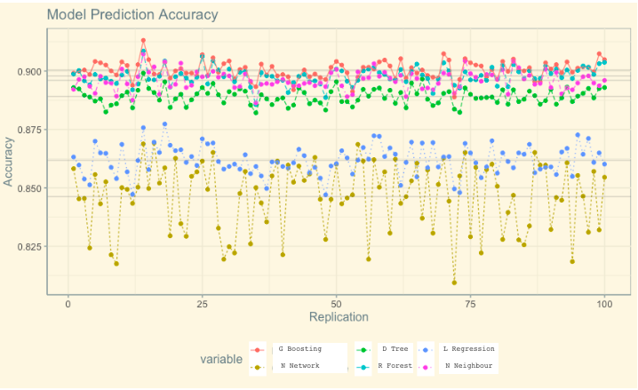
Model Prediction and Accuracy
Prediction of Best 3 Models
Accuracy of each model
D Tree G Boosting R Forest
Fig 1 Fig 2

Slide 6
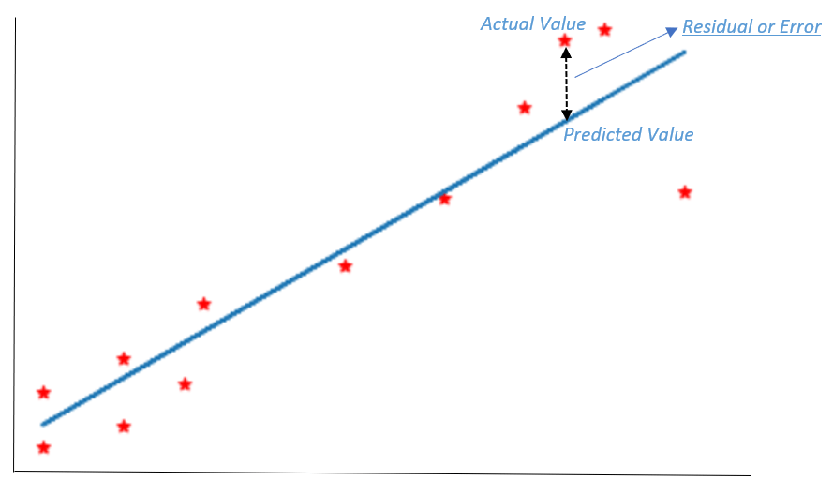
Evaluation of the models
R-squared value
Random Forest: 0.779
Linear Regression: 0.730
Decision Tree: 0.8131
Gradient Boosted Trees: 0.877
Nearest Neighbour: 0.813
Neural Network: 0.068

Slide 7
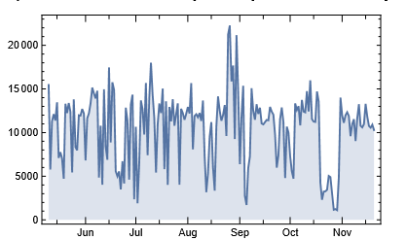
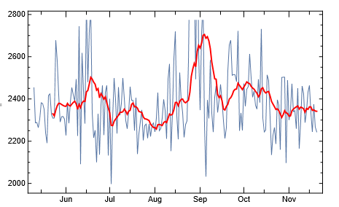
Future prospect?
Fitbit data set (Dynamic Data)
Thank You!

